Slide 1
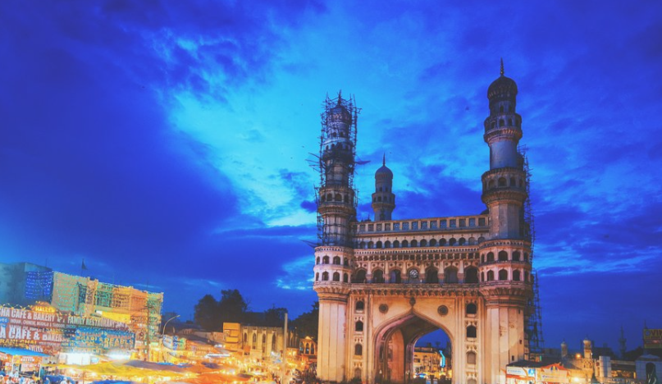
ANALYSIS ON TELANGANA GOVERNMENT’S TOURISM DEPARTMENT

Slide 2
Telangana State
It is the eleventh-largest state and the twelfth-most populated state in India as per the 2011 census.
Telugu one of the classical languages of India is the official language of Telangana and Urdu is the second official language of the state.[62] About 75% of the population of Telangana speak Telugu and 12% speak Urdu.
Telangana State Tourism Development Corporation (TSTDC) is a state government agency which promotes tourism in Telangana.[92] Telangana has a variety of tourist attractions including historical places, monuments, forts, waterfalls, forests and temples.
The state has a rich tradition in classical music, painting and folk arts such as Burra Katha, shadow puppet show, and Perini Shivatandavam, Gusadi Dance, Kolatam and Bathukamma.

Slide 3
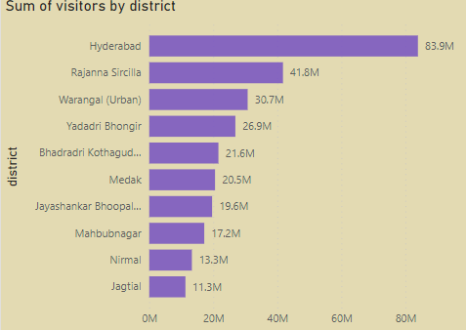
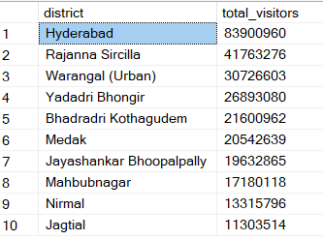
1) List down top 10 districts that have highest no of visitors overall(2016-2019)
Hyderabad district is having highest number of domestic visitors overall followed by Rajanna Siricilla.
Improving transportation infrastructure and parking facilities in these districts can significantly enhance the visitor experience, thereby attracting more tourists in the future.
Making online hotel booking facilities effortless with attractive package deals would be effective.

Slide 4

2) List down top 3 districts based on compounded annual growth rate(CAGR) during (2016-2019)
CAGR=(Ending Value/Beginning Value​)^(1/Number of Years)​−1
Where:
Ending Value is the number of visitors in 2019.
Beginning Value is the number of visitors in 2016.
Number of Years is 2019 - 2016 = 3 years.
CAGR-percentage is highest for Mancherial followed by Warangal(Rural) and Bhadradri Kothagudem district.
This indicates customer footfall has increased for these districts over the years.

Slide 5
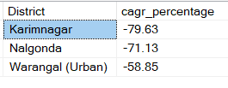
3) List down bottom 3 districts based on compounded annual growth rate(CAGR) during (2016-2019)
Bottom 3 districts in CAGR rate is Karimnagar, Nalgonga followed by Warangal(Urban) district.
Visitors in these districts have declined over the years.
Government may develop infrastructure, roads, temples ,tourist spots and accommodations in order to increase the visitors footfall.

Slide 6
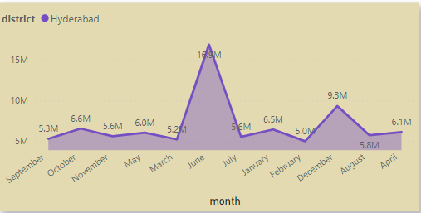


4.1) What are the peak and low season months in Hyderabad based on the data from 2016 to 2019 ? (Domestic)
.June is the month of summer vacation for school students and semester break for college students. As a result, a significant increase in tourists can be seen in this month.
In December, Hyderabad experiences temperatures ranging from 15°C to 27°C, creating a pleasant and cool atmosphere ideal for sightseeing and engaging in outdoor activities.
February and October are the months of annual examinations in India which leads to the lowest footfall in Hyderabad during that session.
Top 3 months
Bottom 3 months
Suggestion
Offering discounts on tickets for popular tourist spots such as Ramoji Film City, Salar Jung Museum, and Golconda Fort during off-seasons can attract more visitors. Additionally, organizing light and sound shows, as well as other musical events, can further enhance the appeal of these attractions and boost tourism in Hyderabad.

Slide 7
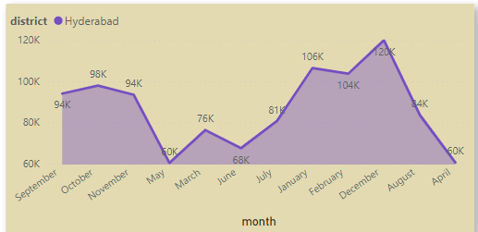


4.2) What are the peak and low season months in Hyderabad based on the data from 2016 to 2019 ? (Foreign)
Foreigners tend to prefer visiting Hyderabad during the pleasant and cooler months of December, January, and February.
To accommodate foreign visitors who avoid extreme summer temperatures, it would be beneficial to offer more air-conditioned accommodations and transportation options. This can enhance their comfort and overall experience during their visit to Hyderabad.
The government could enhance publicity efforts to highlight the advantages of visiting tourist destinations during the summer season. Furthermore, organizing additional evening activities can complement these efforts and promote tourism in the region.
Top 3 months
Bottom 3 months

Slide 8
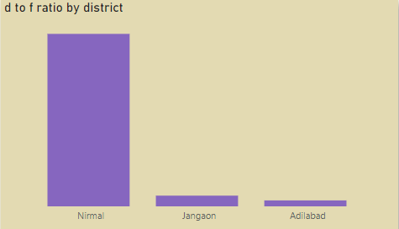

5.1) List down top 3 districts with high domestic to foreign tourist ratio during (2016-2019)
D to F ratio = Domestic visitors/Foreign visitors
Nirmal, Jangaon and Adidabad have attracted domestic visitors more than foreign visitors.In Nirmal there is 1 foreign visitor in every 6657898 domestic visitors.
Foreign visitors play a significant role in revenue generation, making their presence crucial for the growth of the tourism sector. Their visits contribute substantially to the development of tourism infrastructure, which, in turn, attracts even more visitors over time.
Government may focus more on these districts and promote the tourist spots with the help of social media influencing and celebrity ambassador

Slide 9
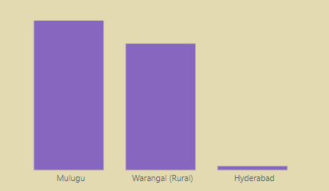
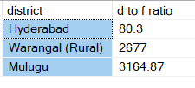
5.2) List down bottom 3 districts with high domestic to foreign tourist ratio during (2016-2019)
Bottom 3 districts are Hyderabad, Warangal(rural) and mulugu in domestic to foreign tourist ratio.
Hyderabad is having 1 foreign visitor in every 80 visitors .This implies highest number of foreign visitors can be seen at Hyderabad in Telangana district.
The government may prioritize this district by ensuring the safety and accessibility of amenities, transportation, food services, and tourist attractions, making them welcoming and secure for foreigners.

Slide 10
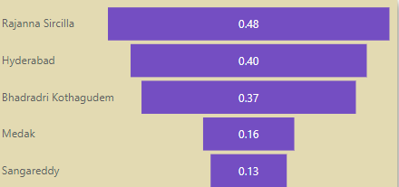
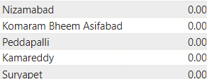
6) List down top and bottom 5 districts based on ‘population to tourist footfall ratio’ in 2019
Bottom 5
Tourist Footfall ratio = Total Visitors / Total Residents Population
Rajanna Sircilla has the highest Population to tourist footfall ratio followed by Hyderabad, Bhadradri, Medak and Sangareddy
Suryapet, Kamareddy, Peddapalli, Komaram Bheem Asifabad,Nizamabad are the bottom 5 districts in tourist footfall ratio. It means they lack the ability to attract the tourists.

Slide 11
Thanks!
Do you have any questions?
doyel.maiti13@gmail.com

